Slide 1
Task Instructions

Slide 2
Instructions
In this experiment, you are going to listen to a series of sentences. As you listen to the sentences, you will be asked whether you think the sentence makes sense or not.
Sentences that do not make sense may have strange meanings (e.g., “John boiled the sky”) or grammatical errors (e.g., “John water boiled”).
You indicate whether you think each sentence makes sense using the computer keyboard.

Slide 3
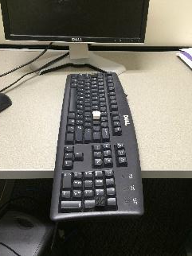
Instructions
The computer keyboard should be oriented as pictured below. The number pad will be closest to you, and the escape key should be farthest from you (near the computer monitor). If the keyboard is not oriented like this, please put it in the proper orientation now.

Slide 4
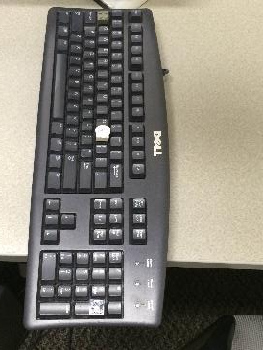
Instructions
You will see three raised keys on the keyboard. The white key in the middle is the “start” button for the task. The black and grey keys at each end of the keyboard are the buttons you will press to make your responses.
grey response key
“start” button
black response key

Slide 5
Instructions
At the beginning of each trial, you will see a “start” screen. When you see this, press and hold down the white “start” button to begin the trial. Hold down the start key with your right index finger.

Slide 6
Instructions
As you are holding down the “start” button, a sentence will be played over your headphones. Keep holding down the “start” button until you are ready to respond.
While the sentence plays, you will see a black or grey square appear on the screen. The color of the square tells you what response needs to be made in order to say that the sentence makes sense.

Slide 7
Instructions
If you think the sentence makes sense, release the “start” button, and press the button with the color (black or grey) that appears on the screen.
If you see a black square on the screen and the sentence makes sense, release the “start” button and press the black button.
If you see a grey square on the screen and the sentence makes sense, release the “start” button and press the grey button.

Slide 8
Instructions
When you respond, you should hit the black or grey button with the same index finger that you used to hold down the “start” button. In other words, you will be moving your hand and arm to hit the appropriate button.
Make sure that you do not release the “start” button before you are ready to respond, as this will terminate the trial.

Slide 9
Instructions
If you think the sentence makes sense, release the “start” button and press either the black or grey response keys as quickly as you can.
If you think the sentence does not make sense, you need to keep holding down the “start” key. You should hold down the “start” key until the black or grey square disappears from the screen.
Once the square disappears from the screen, the trial will end.

Slide 10
Instructions
A trial will end when you press the black or grey response keys (for sensible sentences), or when the black or grey square disappears from the computer screen (for sentences that do not make sense).
There will be a brief pause after each trial, after which the “start” screen will reappear on your monitor. You should press and hold down the white “start” key to initiate the next trial.

Slide 11
Instructions
Listen carefully to each sentence, and decide whether or not it makes sense.
As soon as you are sure that the sentence makes sense, release the “start” button and press the appropriate response key. Respond as quickly and accurately as you can.
If the sentence does not make sense, continue pressing the “start” button until the trial ends.

Slide 12
Instructions
Before you begin the task, your experimenter will ask you a few questions to make sure you understand the task.
Once you have begun the experiment, there will be a few practice trials to get you accustomed to the task. After the short practice session, the experiment will begin.
You will now work with your experimenter to make sure you understand the task.

